Slide 1


BrainBuzz Website
An Automated MCQ-Based Quiz Platform
Branch: CSE-R (B.Tech Sem 4)
Subject Code: ICS-454 (Mini Project)
Team Members:
Abhishek Yadav (2400520100006) • Aditya Pal (2400520100009)
Antrikshya Gupta (2400520100018) • Archit Saxena (2400520100021)
Ayush Sharma (2400520100026)

Slide 2

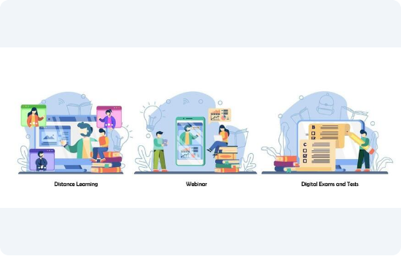
Introduction
The education sector is rapidly digitizing, yet many assessments remain manual.
Traditional Methods: Paper-based quizzes require significant manual effort for checking and result compilation.
Online Forms: Standard forms often lack robust security, time controls, and attempt restrictions.
BrainBuzz Solution: A dedicated, secure, and automated platform tailored for educational institutes to streamline the entire examination process.

Slide 3


Problem Statement & Objectives
The Problem
The Objectives
Multiple Attempts: Students can easily resubmit answers in basic forms.
Secure Platform: Restrict students to a single attempt per quiz.
Answer Sharing: Lack of randomization makes it easy to copy.
Automation: Instant evaluation of answers and score generation.
Manual Effort: Teachers spend hours grading papers.
Efficiency: Easy quiz creation and link sharing for teachers.
Difficult Analysis: No automated way to visualize class performance.
Analytics: Organized dashboard for result analysis.

Slide 4











Proposed System Features
Teacher Portal
Student Access
Fair Assessment
Auto-Evaluation
Secure login to create quizzes, manage questions, and view a detailed results dashboard.
Hassle-free access via shareable links. Students enter Roll No. to start. No signup required.
Questions are randomized, and the system strictly enforces a single-attempt policy.
Immediate score calculation and data storage upon submission.

Slide 5

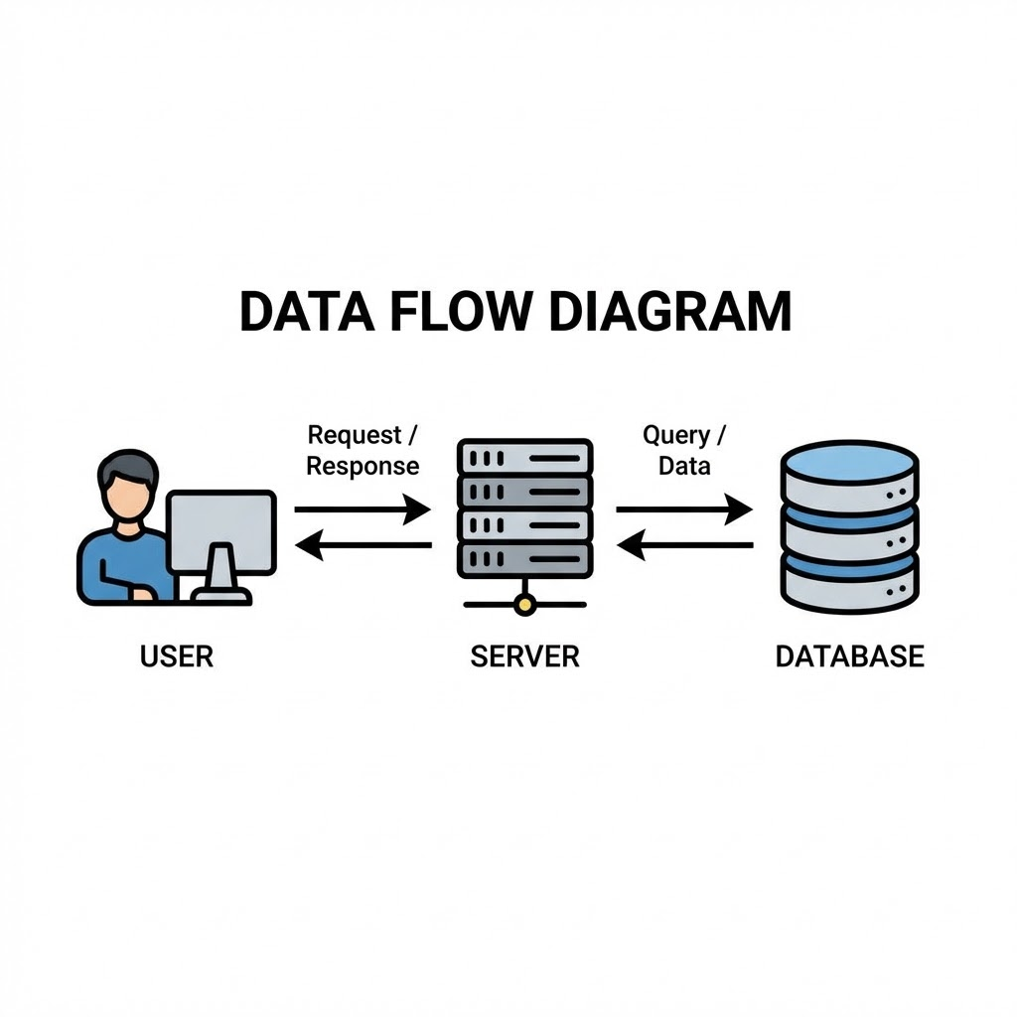
System Architecture
Data Flow: User ↔ Server ↔ Database
1. Frontend (User Interface):
React.js provides a responsive interface for both Teachers (Dashboard) and Students (Quiz Window).
2. Backend (Logic Layer):
Node.js & Express.js handle API requests, validate student sessions, and process quiz logic.
3. Database (Storage):
MongoDB Atlas stores quiz data, student profiles, and submission results.

Slide 6


Tools & Technologies Used
Frontend: React.js, HTML, Lucide React, Tailwind CSS
Backend: Node.js, Express.js
Auth: JWT (JSON Web Tokens)
Database: MongoDB Atlas
Language: JavaScript (ES6+)
Security: Bcrypt (Hashing)

Slide 7

Implementation Details
Teacher Dashboard: A protected route allowing teachers to design quizzes, set time limits, and add questions.
Quiz Interface: A clean, distraction-free UI for students. It loads questions dynamically and tracks selected answers.
Result Processing: Once submitted, the backend compares answers against the key, calculates the score, and updates the database instantly.

Slide 8

Project Results
Successful Deployment: The platform successfully allows teachers to register and create quizzes.
Attempt Control: The system effectively blocks students from retaking the same quiz.
Automated Grading: 100% accuracy in MCQ evaluation, eliminating manual errors.
Data Organization: Results are displayed in a sorted, organized format for easy analysis.
Status: Backend and Database Prototype Ready

Slide 9



Conclusion
Summary
Provides a secure online quiz system.
Significantly reduces manual effort for faculty.
"BrainBuzz transforms the traditional assessment process into a secure, efficient, and digital workflow."
Improves fairness in assessment through randomization.
Enables easy performance tracking via digital records.

Slide 10

Future Scope
Leaderboard: Gamification to encourage competition.
Student Login System: Profiles to track history.
Mobile App: A dedicated Android/iOS application.
Data Export: Download results as Excel/PDF.
Question Bank: Repository for reusing questions.

Slide 11


References
Documentation
Node.js Official Documentation
MongoDB Manual & Docs
Thank You!
React.js Official Documentation
MDN Web Docs (Mozilla)

